Slide 1
ELEC4830/BIEN 4310 Final Project
Yifan HUANG，Xiang ZHNAG
2019-05-05
Notes:
Now i’m gonnai introduce that you ‘re gonna work on.

Slide 2
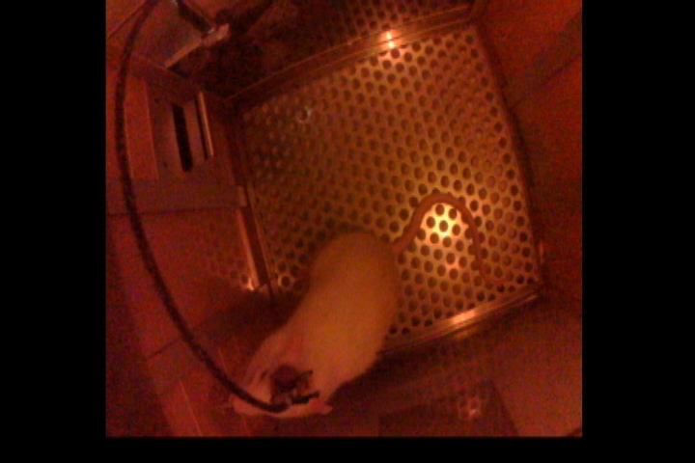
Experiment paradigm
Notes:
The project background, which is an experiment on rats.
As you can see here, wire connecting to electrode arrays inserted into the rat’s brain.
And with the elctrodes can record the extracellurer firings in certain brain area, experiment, primary motor cotex area.
In this expriment, whenever rats heard a cue, then it’s supposed press the lever, in order to get a drop of water as reward. You can see the whole process form video. (lower the voice)

Slide 3
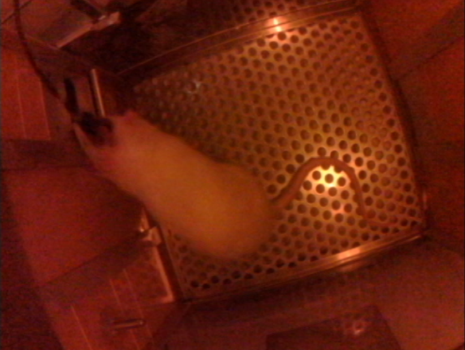
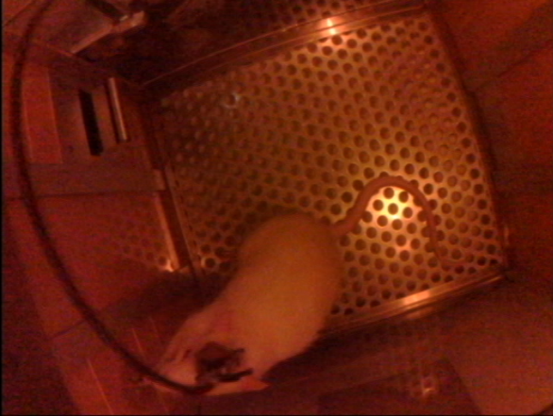
Objective
Given the brain signals: 16-channel neural spikes in the primary motor cortex (M1) of a rat.
Classify the lever-press states of the rat (press or rest).
Press
Rest (not press)
Notes:
Binary
Provided brain signals

Slide 4
Procedure
Neural firings
for training
train the parameters for the algorithm (Wiener filter, Kalman filter, SVM, Neural, network etc.)
Training
Rat’s lever-press state for training
Neural firings
for testing
Decoded
rat’s lever-press state
Testing
Submit decoded result
Then we’ll compare your submissions with ground truth. Higher accuracy on test data is better.
Notes:
数据名称写上来
Training data, including
Testing brain signals that i provided to decode
Note you don’t regularization, cross validation.

Slide 5
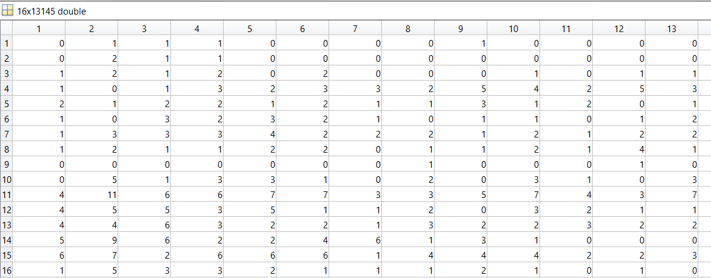
Data description
trainSpike (16X13145)
Row represents different channel
Column represents the time sequence of the experiment
Value represents the spike count in that time window (100ms)
400~500ms
trainSpike (i, j) represents the spike count in the time interval (j-1)*100 ~ j*100 ms of the i-th channel .
Channel 12
Notes:
entry

Slide 6

Data description
trainState (1X13145)
Column represents the time sequence
0 represents the rest (not press) state
1 represents the press state
NaN means the state is not clear, we do not use these states to train our model
149700~149800ms
Notes:
Generally we do not these states to train our model.

Slide 7
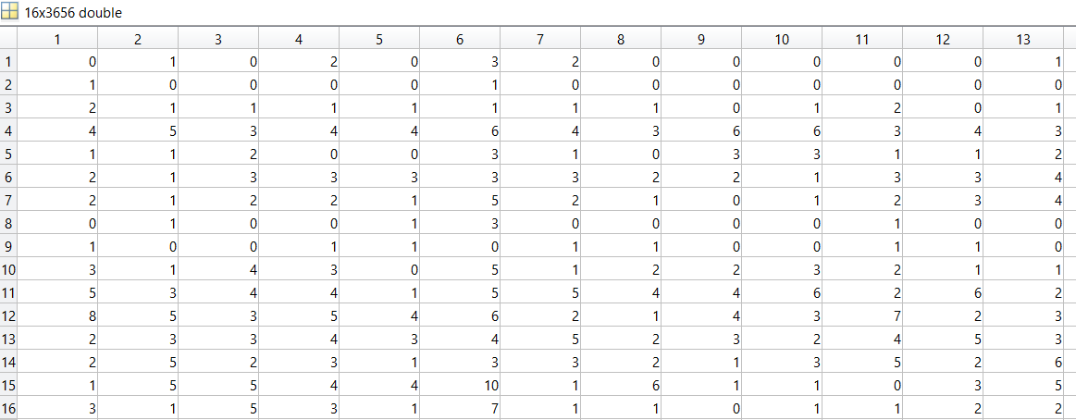
Data description
testSpike (16X3656)
Structure of testSpike is the same as trainSpike
Decode the rat’s state for all the time stored in testSpike, and obtain testState(1X3656)

Slide 8
Step 0. Check the training data
Roughly 60%
Lower bound
Roughly 70%
Notes:
Here are some steps that i think you could take
HIGH dimension
raw data is unfornately,
2D PCA
3D
Without considering history

Slide 9
Step 1. Preprocessing (e.g. consider history)
The rat’s movement is a continuous process
The previous spikes might contribute to the current movement
Consider spike history might help improve the decoding results
t-n
t-2
t-1
t
Notes:
Turn right, reach the lever. Press it .
Which is reasonable right, before rats , he was thinking about press the lever

Slide 10
Step 2. Run your algorithms
You can call the existing functions of any algorithm
No need to implement the algorithm by yourself
You need to specify how you use the existing functions
What is your input
What is your preprocessing
How you improve the performance of your training (e.g. search for the best parameters)
What is your output
etc.
Notes:
Call the NN or SVM from a existing library.

Slide 11
Tips for different algorithms
Wiener filter and Kalman filter
Smooth the output instead of 0,0,0,1,1,1,0,0,0
SVM
Normalize the spike count
Put equal number of samples in each category
Neural Network
Try different initial weights and learning rate
Randomize the training sample
Aviod Overfitting
Notes:
Cross validation. do not overfitting
Put the number of samples of two categories to be equal.

Slide 12
Submission name format
Your name_student ID.zip (edem_12344321.zip)
main.m You should write some simple comments on your code, we will re-run your code
result.mat The decoding result of the test spike should be stored in a variable called decodedState (row vector, 1X3656)
report.pdf

Slide 13
Report
No more than 3 pages
No need to introduce the algorithm itself
Focus on the procedure of how you deal with the training data and the testing data
Preprocessing (e.g. Include history)
Data checking (e.g. PCA )
Parameter exploration (e.g. Initial weights, learning rate etc.)
Confusion matrix on the training data (Too high or too low are not good)
Deadline: two weeks from now
Notes:
Focal points

Slide 14
Q&A

